Slide 1
PHYS 304: Lecture 19 (Intro to) Quantum Mechanics
Sept-Dec 2021 Edition
Jeff Young
brimacombe Rm 278, young@phas.ubc.ca

Slide 2
Review of key points from last lecture
Two distinct uncertainty relations, one in terms of the variances of two observables, the other in terms of the variance of energy and a time over which some other observable might noticeably change. Both are specific to a particular state of the system, and both specify inequalities that must be satisfied.
Implications are subtle, especially when considering stationary states, where variances can be zero, or arbitrarily close to zero.

Slide 3
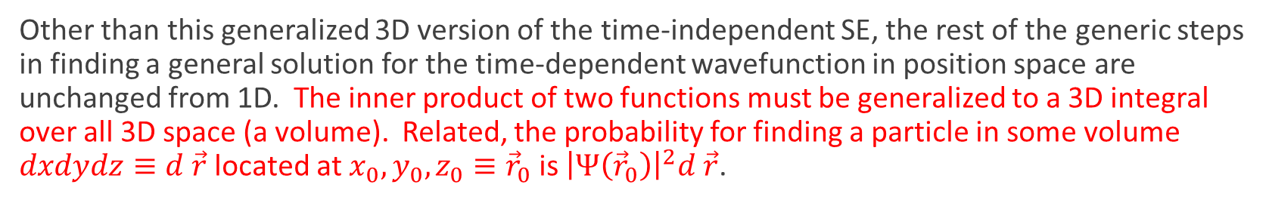
Review of key points from last lecture
Useful to systematically make the transition from 1D to 3D in steps: i) total energy for classical treatment of single electron in 3D, expressed in terms of position and momentum vectors, ii) convert to a basis-agnostic Hamiltonian operator just by “adding hats” to the position and momentum operators (both of them!!), iii) then render in the QM position basis, first using cartesian coordinate system to express the vector components.
Other than this generalized 3D version of the time-independent SE, the rest of the generic steps in finding a general solution for the time-dependent wavefunction in position space are unchanged from 1D. The inner product of two functions must be generalized to a 3D integral over all 3D space (a volume). Related, the probability for finding a particle in some volume $dxdydz≡d \vec{r}$ located at $x_{0},y_{0},z_{0}≡{\vec{r}}_{0}$ is ${\left|Ψ\left({\vec{r}}_{0}\right)\right|}^{2}d \vec{r}$.
Adding more than 1D brings rotational motion into play, which in the QM context, means there are a lot more “interesting” observable operators to define and work with (e.g. angular momentum)

Slide 4
Today
Examine the infinite 3D square well potential solution and implications.
Examine the spherically-symmetric central potential problem.

Slide 5
Infinite cubic square well potential: con’t
The solution of the 3D time independent SE for a potential that is infinite everywhere except inside a cube with one corner at the origin, (0,0,0), and one at (a,a,a).
$ψ_{n_{x},n_{y},n_{z}}\left(x,y,z\right)={\left(\frac{2}{a}\right)}^{\frac{3}{2}}sin⁡(\frac{n_{x}πx}{a})sin⁡(\frac{n_{y}πy}{a})$ $sin⁡(\frac{n_{z}πz}{a})$
Physical interpretation of $n_{x},n_{y},n_{z}$?
Notes:
Write correct time-independent SE (- \del^2 \psi = E\psi)
Show e^{i \vec k \cdot \vec r} is a valid form of the general solution before using BCs
Write out as product of 3 functions of x, y, and z
Note that BCs are such that can easily use them with this form of the general solution (what would be the issue if it were a sphere rather than a cube?

Slide 6
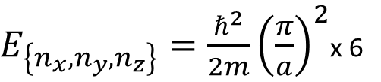
Poll #1
How many states have an energy equal to twice the lowest possible energy?
$E_{\left\{n_{x},n_{y},n_{z}\right\}}=\frac{ℏ^{2}}{2m}{\left(\frac{π}{a}\right)}^{2}$x 6

Slide 7
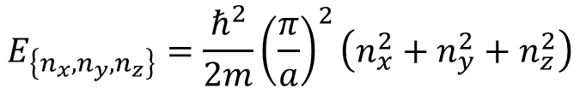
Contrast with 1D
What is fundamentally different here compared to examples we did in 1D?
$$E_{\left\{n_{x},n_{y},n_{z}\right\}}=\frac{ℏ^{2}}{2m}{\left(\frac{π}{a}\right)}^{2}\left(n_{x}^{2}+n_{y}^{2}+n_{z}^{2}\right)$$
Degeneracy: linked to symmetry properties of $V(\vec{r})$
Level spacings: note while doing problem set.
Notes:
V has symmetries: if you look at a plot of V, you can’t tell which of 3 different actual directions the view might be taken from, so any solution of the TISE must also be invariant under the same change in perspective (in this case, interchange x,y or x,z or y,z.

Slide 8
Properties of degenerate states:
The superposition of degenerate stationary solutions of the SE with the same eigen energy:
Notes:
They are also eigen states of the Hamiltonian operator, with the same eigen value. More generally linear combinations of degenerate eigen states of any Hermitian operator are also eigen states with the same eigen value. Show Matlab sims.

Slide 9
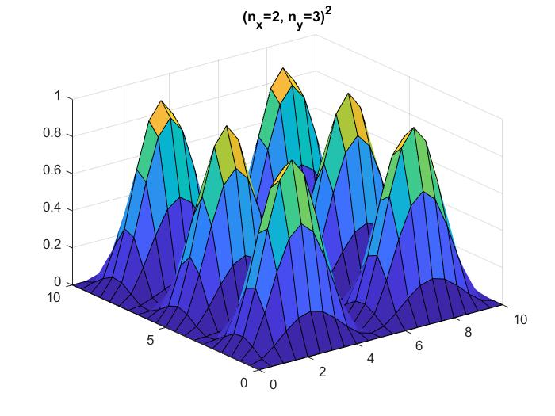
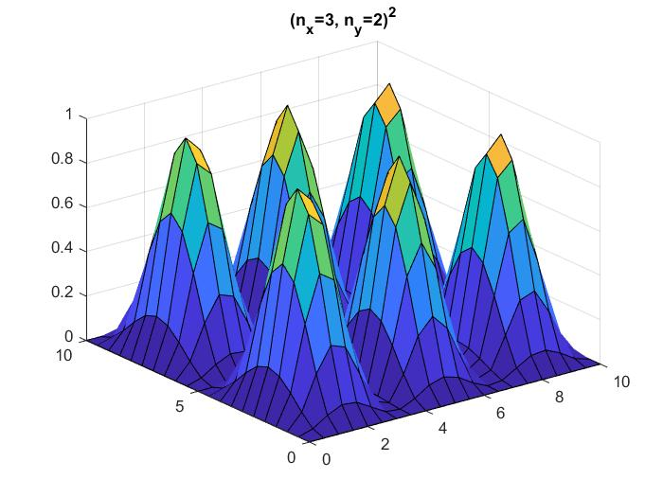
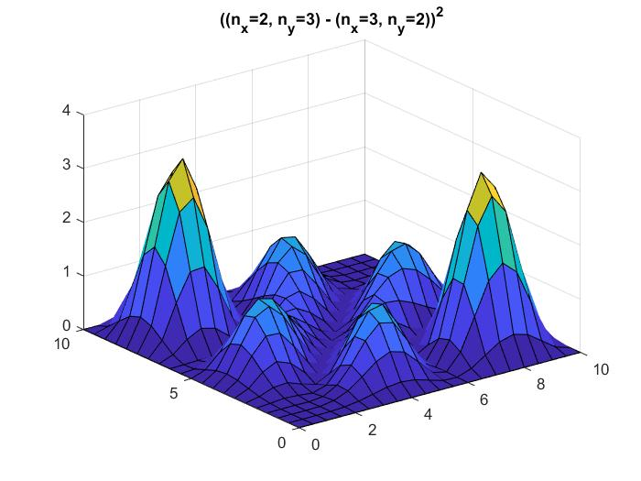
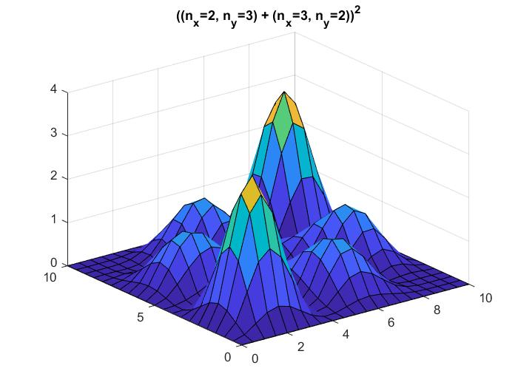
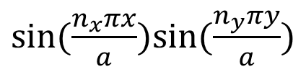
$sin⁡(\frac{n_{x}πx}{a})sin⁡(\frac{n_{y}πy}{a})$
What do they share in common?
Notes:
Number of nodes. Note identical if rotate view by 90 degrees

Slide 10
Central Potentials (e.g. atoms/hydrogen)
What comes to mind when you think about “the hydrogen atom”?
This is our first example of a “real” physical system. Within the non-relativistic limit, what terms do you think one would have to include in the Hamiltonian describing a single hydrogen atom in vacuum, in general?
What simplifying approximation(s) seem appropriate when thinking of how to define the Hamiltonian to solve in the time independent SE for “the hydrogen atom”, if you are aiming primarily to understand what colours of light would be emitted from a collection of hydrogen atoms in a fluorescent tube?
Notes:
Generally have to include the KE of the proton, more generally still, should write down individual Hamiltonians for the quarks that make up the proton (KE and interactions), and should in principle also include the Hamiltonian of the vacuum (photon bath), as the Coulomb potential is a simplification of the full EM interaction of the charged particles and the vacuum EM fields.
Assume it’s CoM motion is not of interest (KE at non-relativistic speeds much less than potential energy of electron-proton binding energy.
Assume it’s internal nuclear state is “a solved problem at a few eV energy scales (shining few eV photons on the atom won’t budget the nucleus)
Assume its interaction rate with the light is very weak.

Slide 11
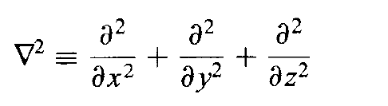
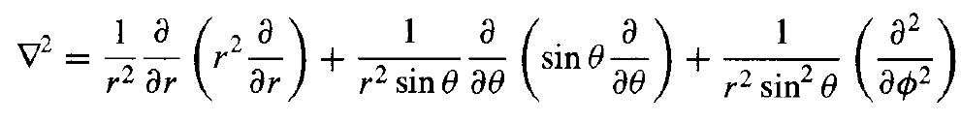
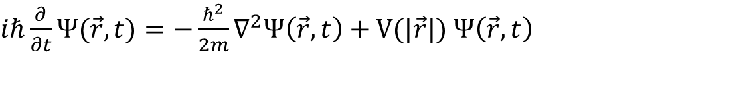
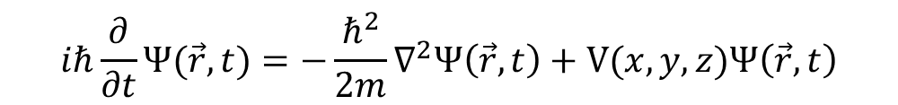
Solving the Schrödinger Equation
$$iℏ\frac{∂}{∂t}Ψ(\vec{r},t)=−\frac{ℏ^{2}}{2m}∇^{2}Ψ\left(\vec{r},t\right)+V(x,y,z)Ψ\left(\vec{r},t\right)$$
$iℏ\frac{∂}{∂t}Ψ\left(x,y,z,t\right)=−\frac{ℏ^{2}}{2m}∇^{2}Ψ\left(x,y,z,t\right)+V(x,y,z)$ $Ψ(x,y,z,t)$
$iℏ\frac{∂}{∂t}Ψ(\vec{r},t)=−\frac{ℏ^{2}}{2m}∇^{2}Ψ\left(\vec{r},t\right)+V(|\vec{r}|)$ $Ψ\left(\vec{r},t\right)$
$iℏ\frac{∂}{∂t}Ψ(r,θ,φ,t)=−\frac{ℏ^{2}}{2m}∇^{2}Ψ\left(r,θ, φ,t\right)+V(r)$ $Ψ(r,θ,φ,t)$

Slide 12
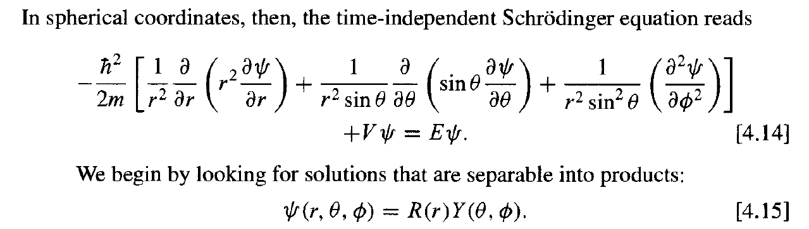
Solving the Schrödinger Equation

Slide 13
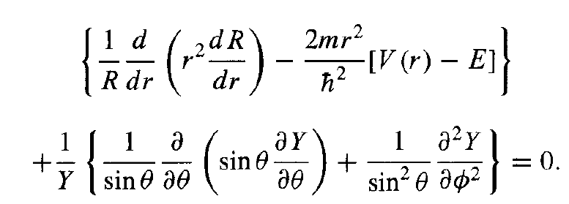
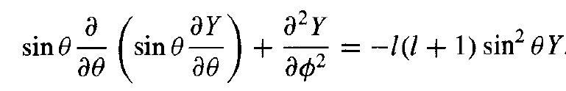
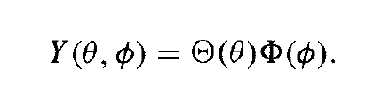
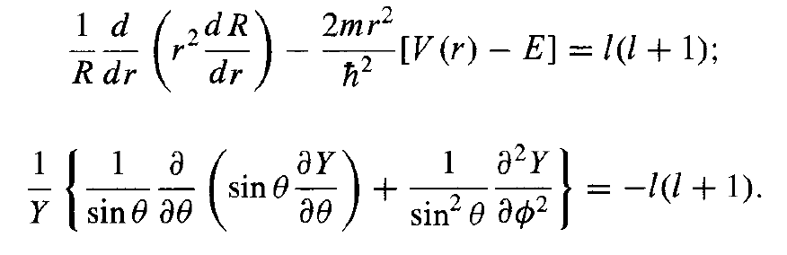
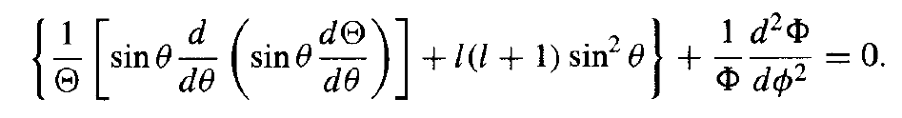
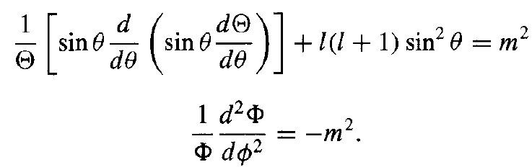
Solving the Schrödinger Equation
The angular equation

Slide 14



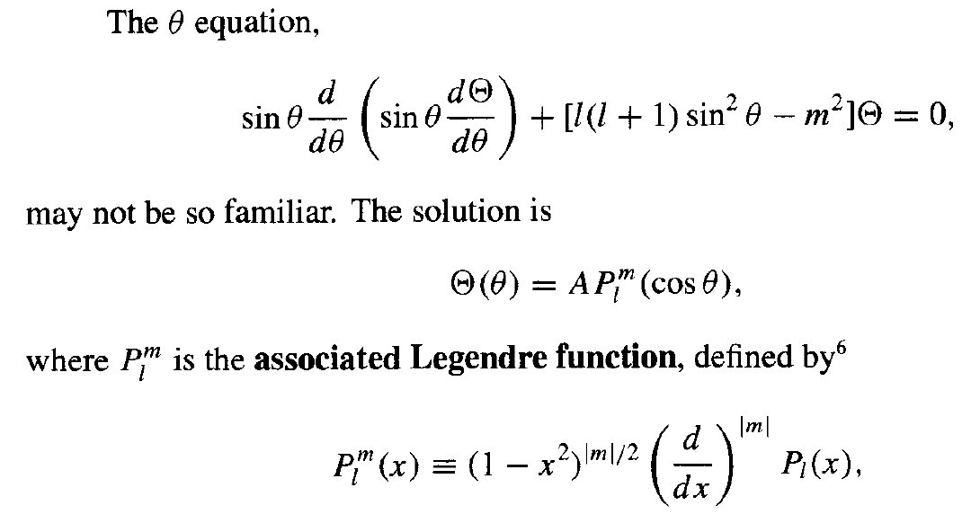
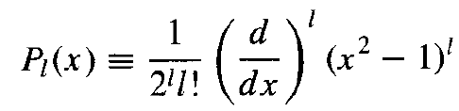
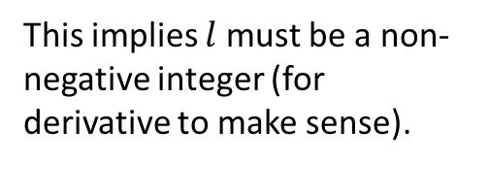
Solving the Schrödinger Equation
Also implies maximum $\left|m\right|=l$.
This implies $l$ must be a non-negative integer (for derivative to make sense).

Slide 15
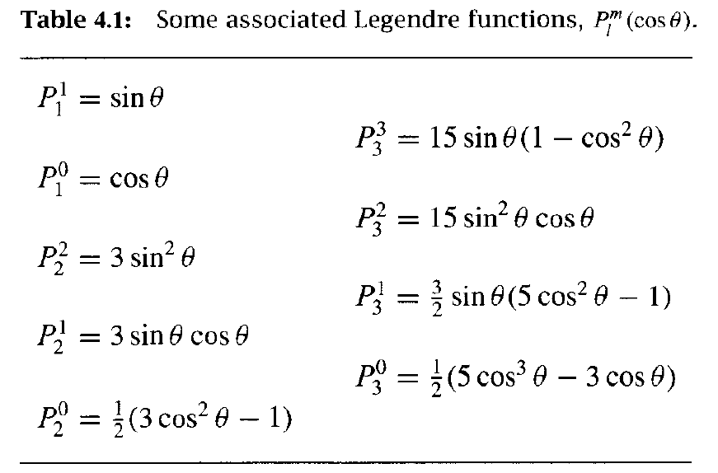
Properties:

Slide 16
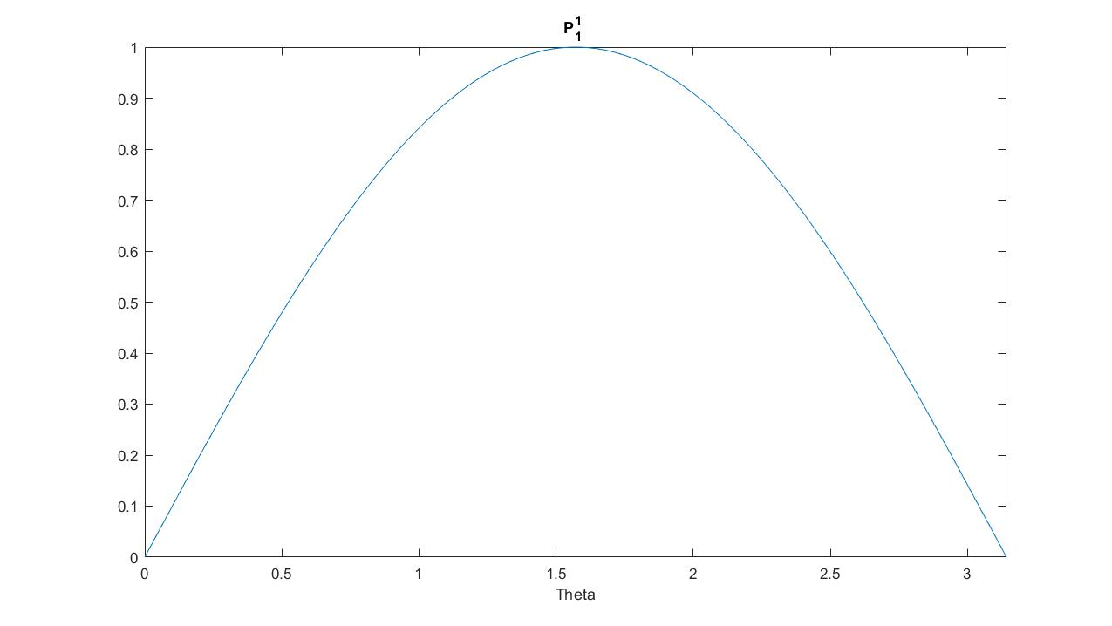
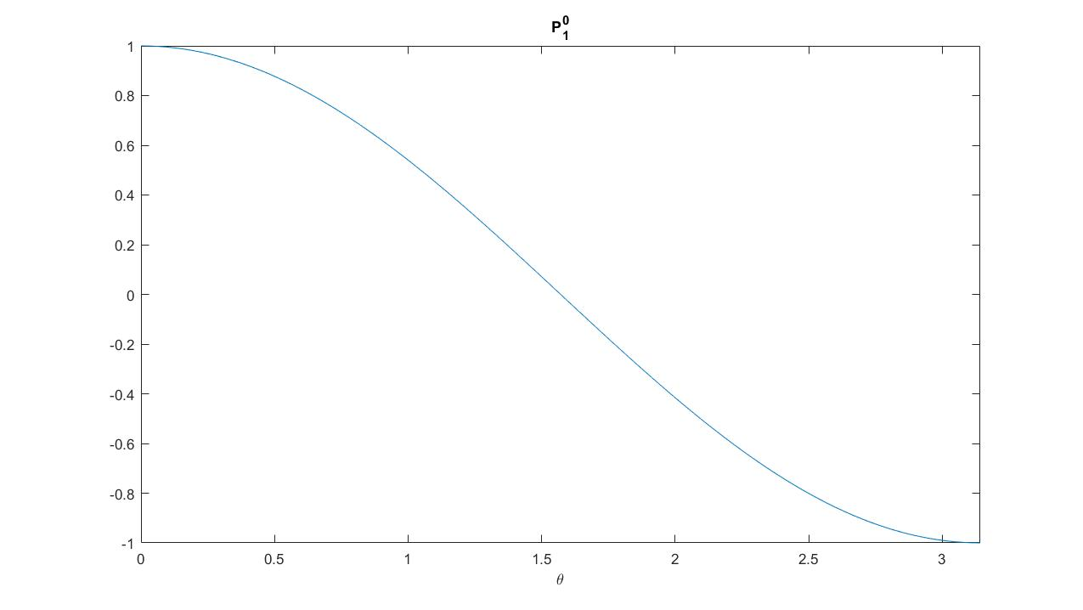


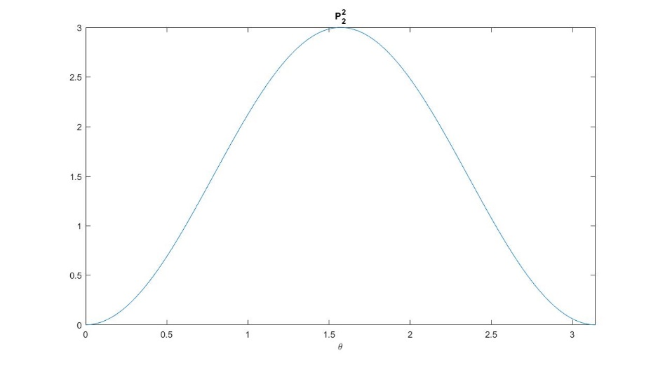
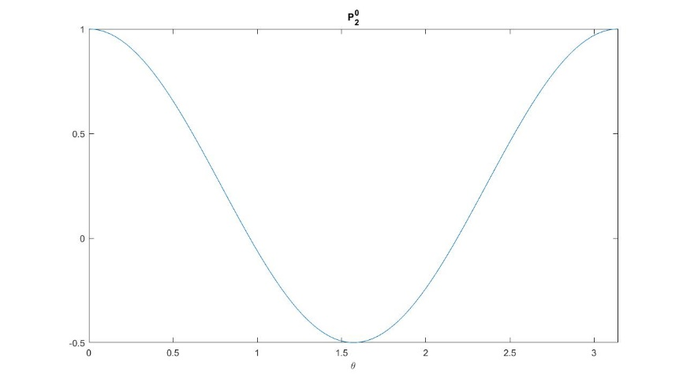

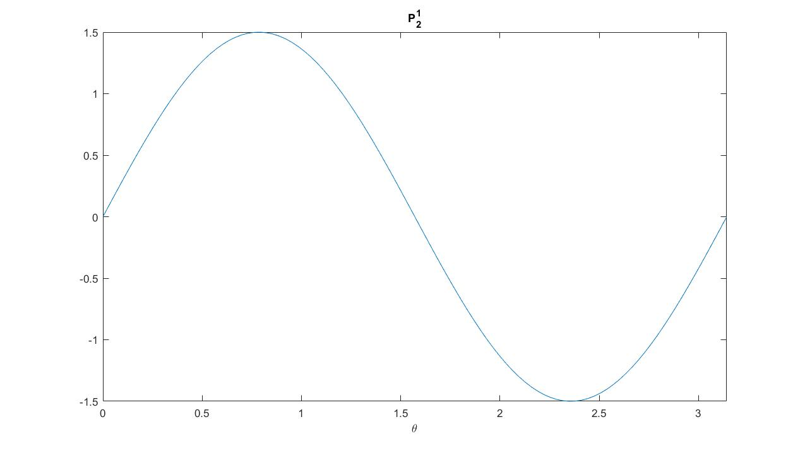


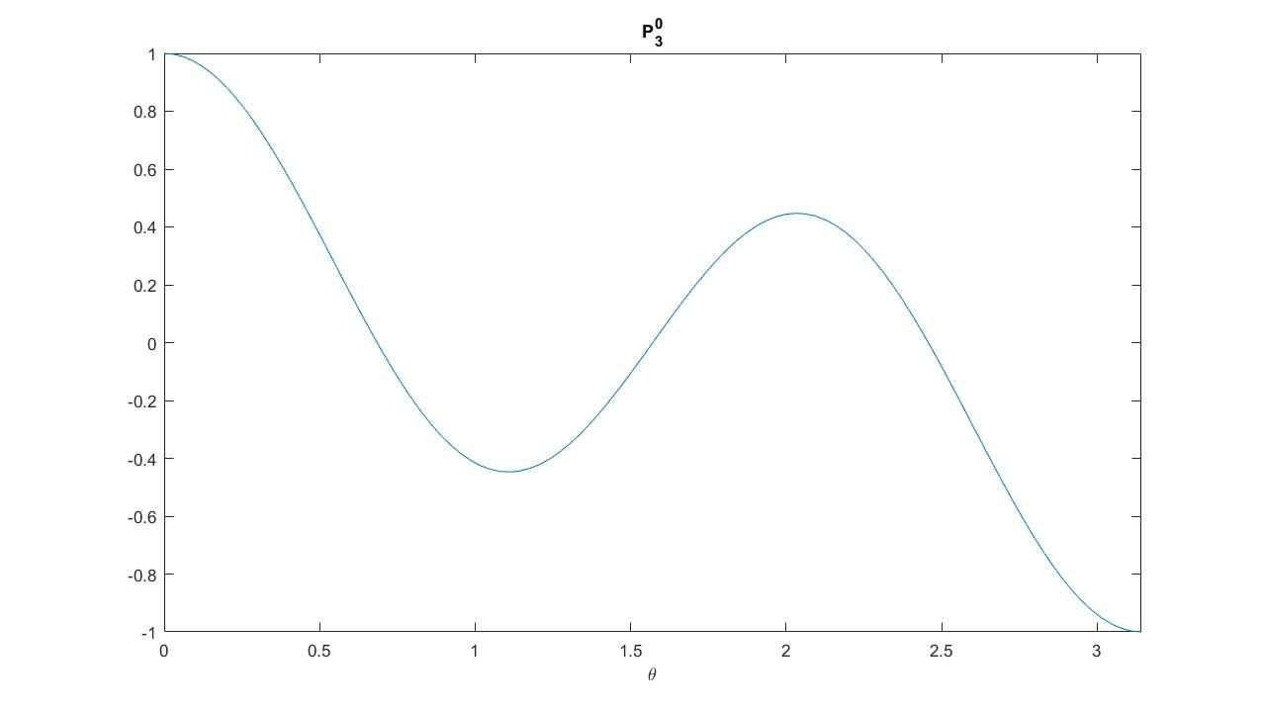




POLL#2: How many nodes are there between 0 <$θ<$ $π$ in $P_{l}^{m}$?
l
m
l+m
l-m
l+|m|
l-|m|
P₂⁻¹=
0 $θ$ $π$
0 $θ$ $π$

Slide 17
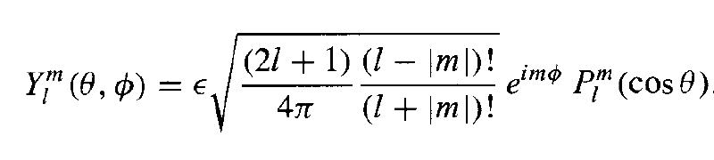
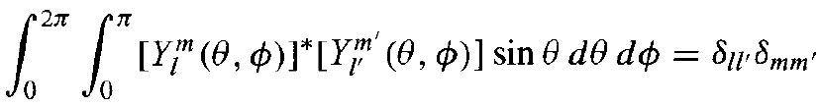
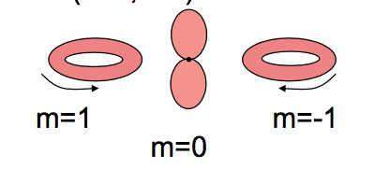
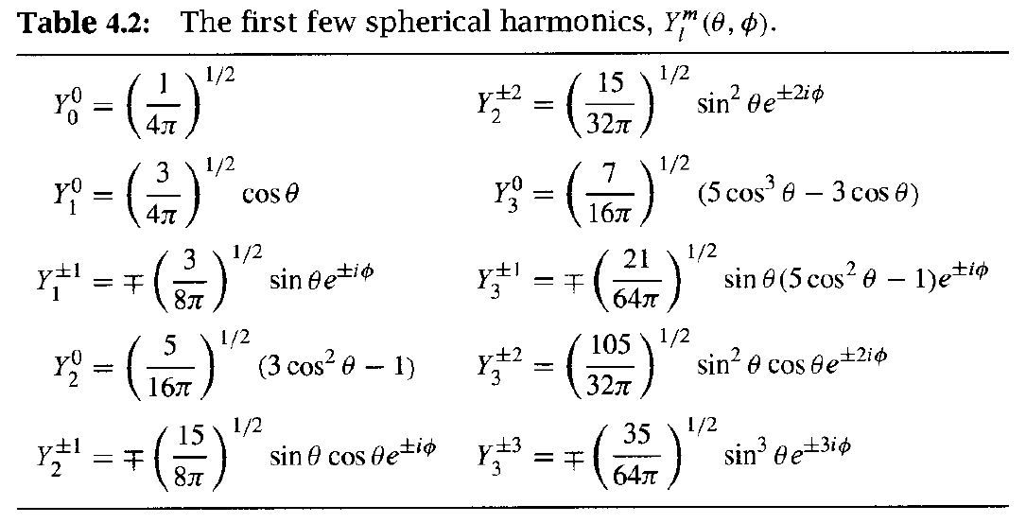
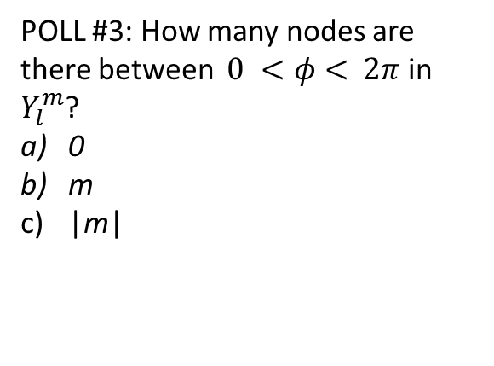
Gory details!
l=1
POLL #3: How many nodes are there between $0 <φ<$ $2π$ in $Y_{l}^{m}$?
0
m
|m|

Slide 18
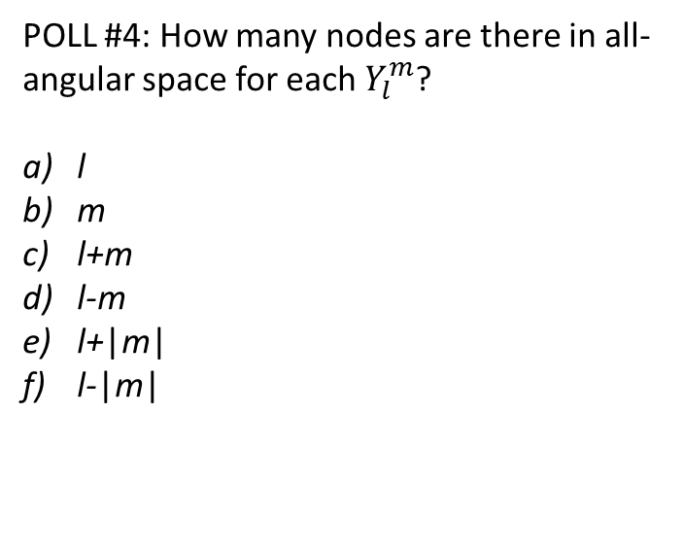
More node accounting
POLL #4: How many nodes are there in all-angular space for each $Y_{l}^{m}$?
l
m
l+m
l-m
l+|m|
l-|m|

